Slide 1
Multi-Platform AI Technology Discussion Landscape Analysis
(Reddit & YouTube)

Slide 2


Project Scope
API Used: Reddit API & YouTube API
The key objectives include:
1) Temporal Analysis: Analyzing posting patterns by hour and day to identify optimal engagement times.
2) Community Comparison: Comparing engagement metrics (posts, comments, votes) across Reddit and YouTube.
3) Technology Trends: Tracking and forecasting discussions on emerging AI technologies.

Slide 3
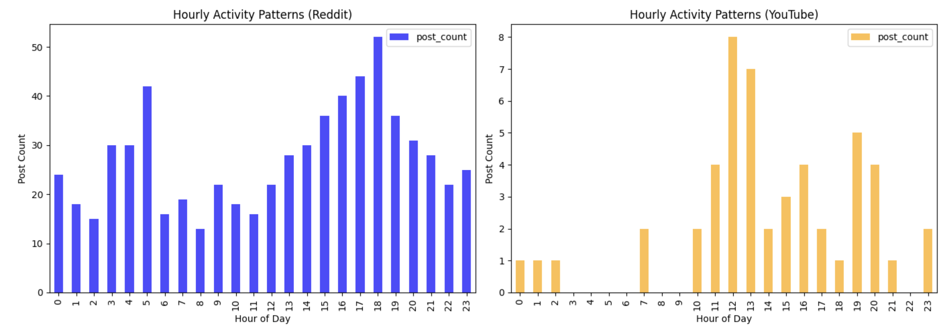
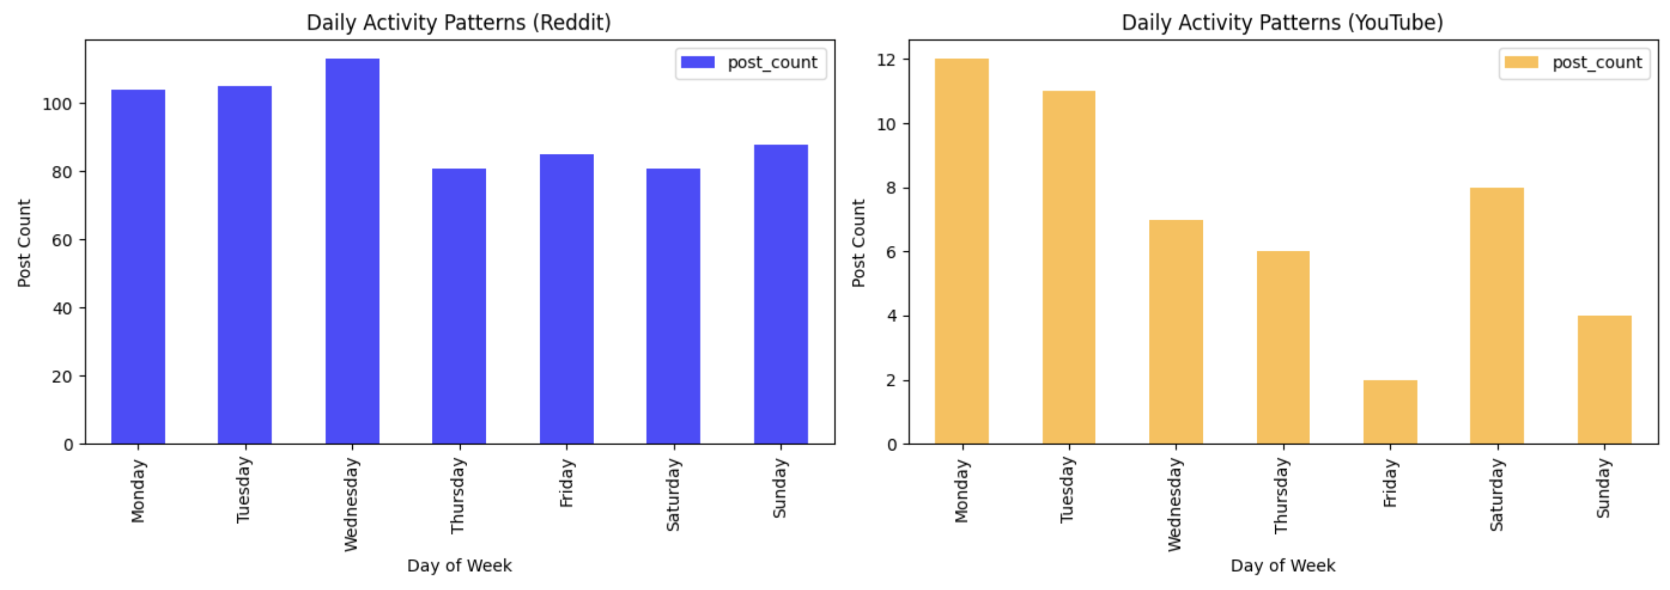
Project Findings - Temporal Analysis
Hourly
Reddit ->16:00-18:00
YouTube ->12:00-13:00
Daily
Reddit ->Wednesday
YouTube ->Monday

Slide 4
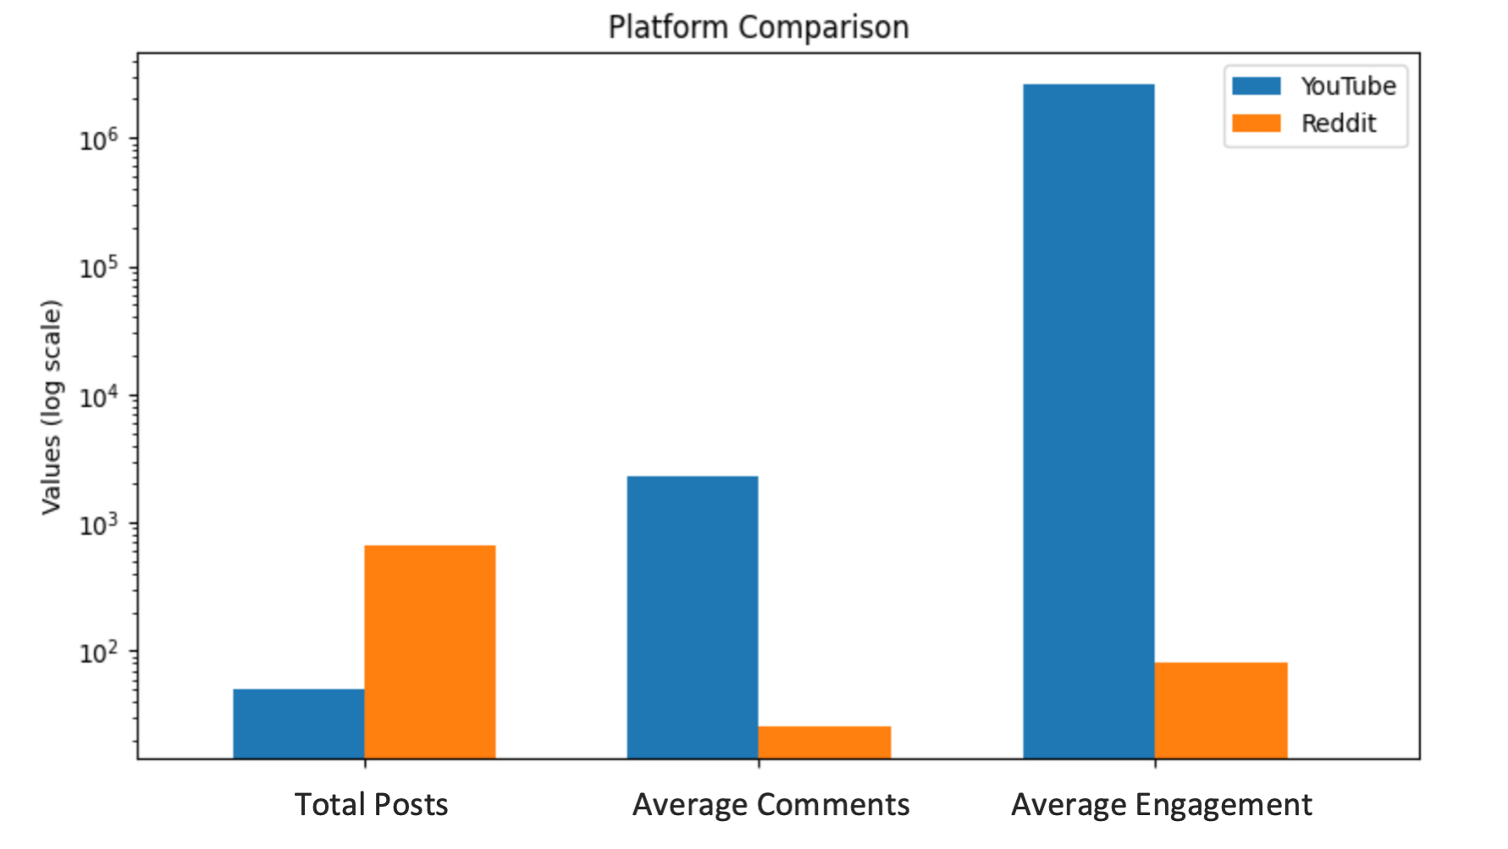

Project Findings - Community Comparison
Total Posts
Reddit has more total posts than YouTube, which suggests that content generation is more frequent on Reddit.
Average Comments
YouTube's average comments are nearly two orders of magnitude higher than Reddit.
Average Engagement
YouTube engagement includes views, likes, and comments, while Reddit is limited to votes and comments, leading to a huge difference.
YouTube, with fewer posts, generates significantly higher engagement and discussion per post, likely due to the greater emotional and visual appeal of video content.

Slide 5
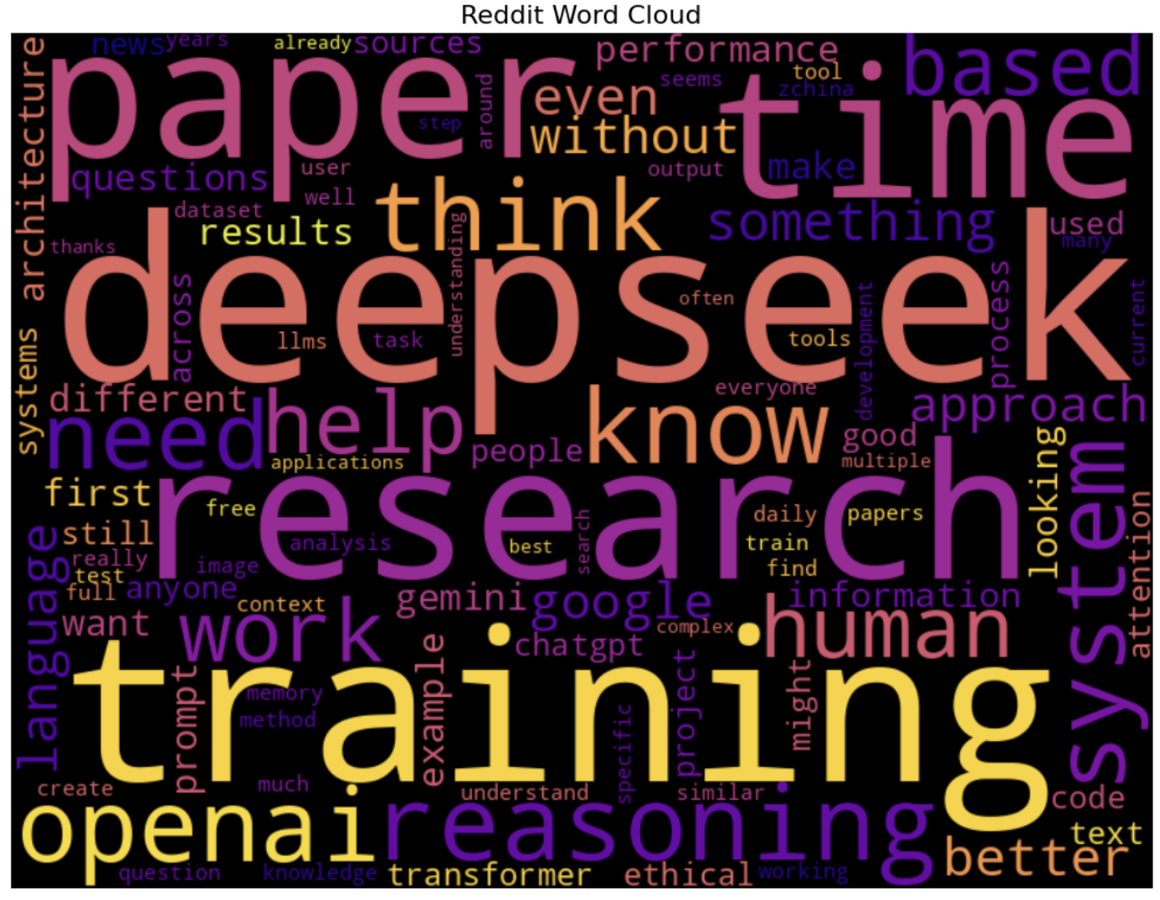
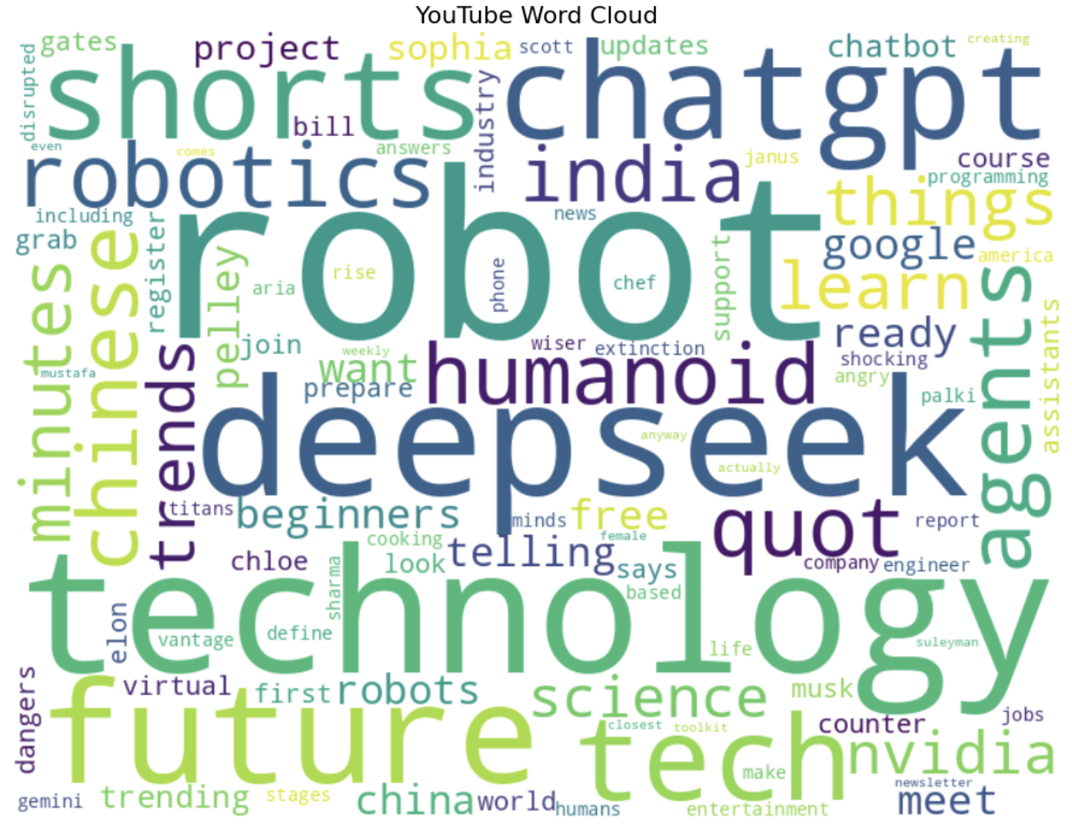
Project Findings - Word Cloud
vs
Reddit is a hub for deep AI discussions, where professionals debate AI development, training methodologies, and ethical concerns.
YouTube serves as a mainstream platform
for AI awareness, where audiences engage with simplified explanations, futuristic AI trends, and big-name figures in the industry.

Slide 6
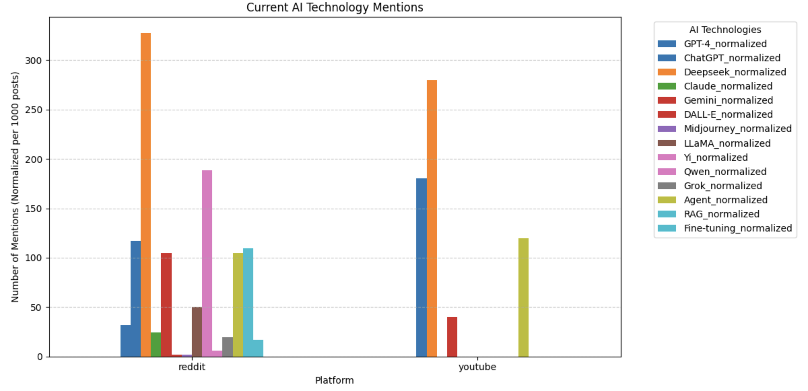
Project Findings - Trend Analysis
Consistent with the word cloud, according to this current AI mentions analysis, Reddit AI discussions are more detailed and widespread across various technologies, while YouTube are more concentrated on fewer technologies.

Slide 7
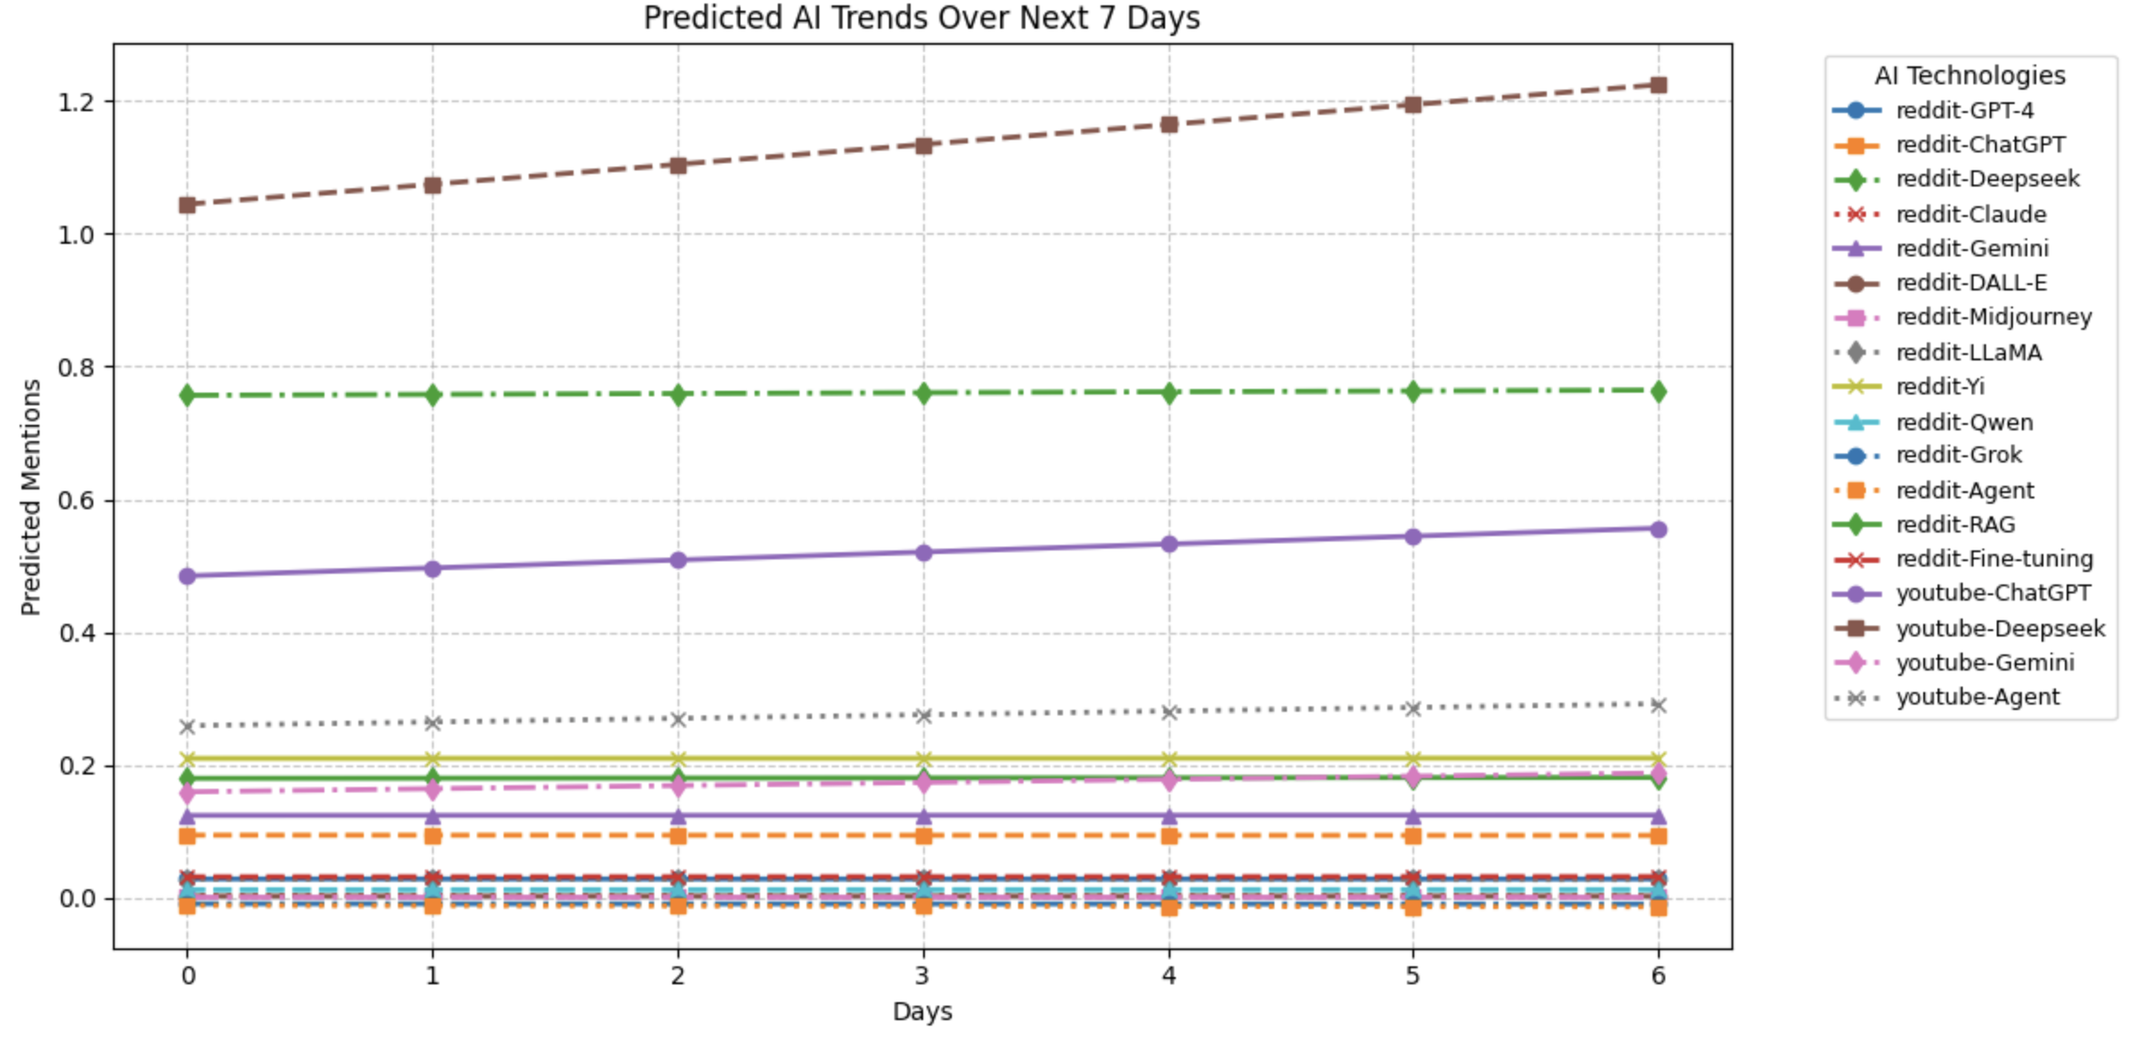
Project Findings - Trend Forecasting
Reddit continues to dominate AI discussions, with predicted mentions of ChatGPT, DeepSeek, and Gemini showing a steady increase, while YouTube AI mentions remain minimal and nearly stagnant over the next 7 days.

Slide 8
Project Implementations
Exploratory Analysis
Predictive Modeling
AI Content Creators & Social Media Marketing
Technology Companies
Leverage temporal analysis to identify
optimal posting times.
(2) Use Reddit & YouTube word cloud analysis to optimize video titles, ad copy, and promotional strategies.
(1) Help tech companies determine which AI domains (e.g., multimodal AI) are worth further development.
(2) Allow them to stay ahead of market demands and secure a competitive advantage.
Public Opinion Monitoring on AI Topics
AI Investment and Financial Analysis
(1) Analyze AI-related discussions particularly concerning AI regulations, privacy, and ethics.
(2) Gauge public sentiment toward AI governance and implement more informed and effective regulations.
(1) Investors: Forecast investment opportunities including startups, stocks, and AI-focused funds.
(2) Venture Capital Firms: Identify emerging AI fields with high potential for long-term success.

Slide 9
Project Limitations
Simplistic Forecasting Model
Textual Analysis Challenges
Limited Data Access
-> API rate limits
-> YouTube's API does not provide dislike counts or detailed engagement metrics for deeper analysis.
-> Linear Regression Model
-> More advanced time-series models like ARIMA, Prophet, or LSTMs could provide better accuracy.
-> NLP technique limits
-> The word cloud method does not account for semantic relationships between words.

Slide 10
Future Work
Apply Advanced Forecasting Models:
Use ARIMA, Facebook Prophet, or LSTMs to improve AI trend predictions.
Ⅲ
Improve Sentiment Analysis:
Use NLP models (e.g., BERT, VADER) to analyze sentiment in AI-related discussions;
Determine whether discussions on AI are positive, neutral, or negative.
Ⅱ
Expand Data Collection:
Increase dataset size to reduce sampling bias.
Ⅰ

